Slide 1
COMMUNITY GARDENING
PRAGATI MAHESHWARI
22BAI1072

Slide 2
introduction
This app help use in finding various community gardens and playgrounds and encourages people towards gardening and this is app even finds out best classes for learning gardening for both adults and kids

Slide 3
PRIMARY GOALS
PROMOTE GRADENING

Slide 4
TO PLANT A GARDEN IS TO BELIEVE IN TOMORROW
“
”
--AUDREY HEPBURN

Slide 5
Tools used:
HTML
CSS(BOOTSTRAP)
PYTHON

Slide 6
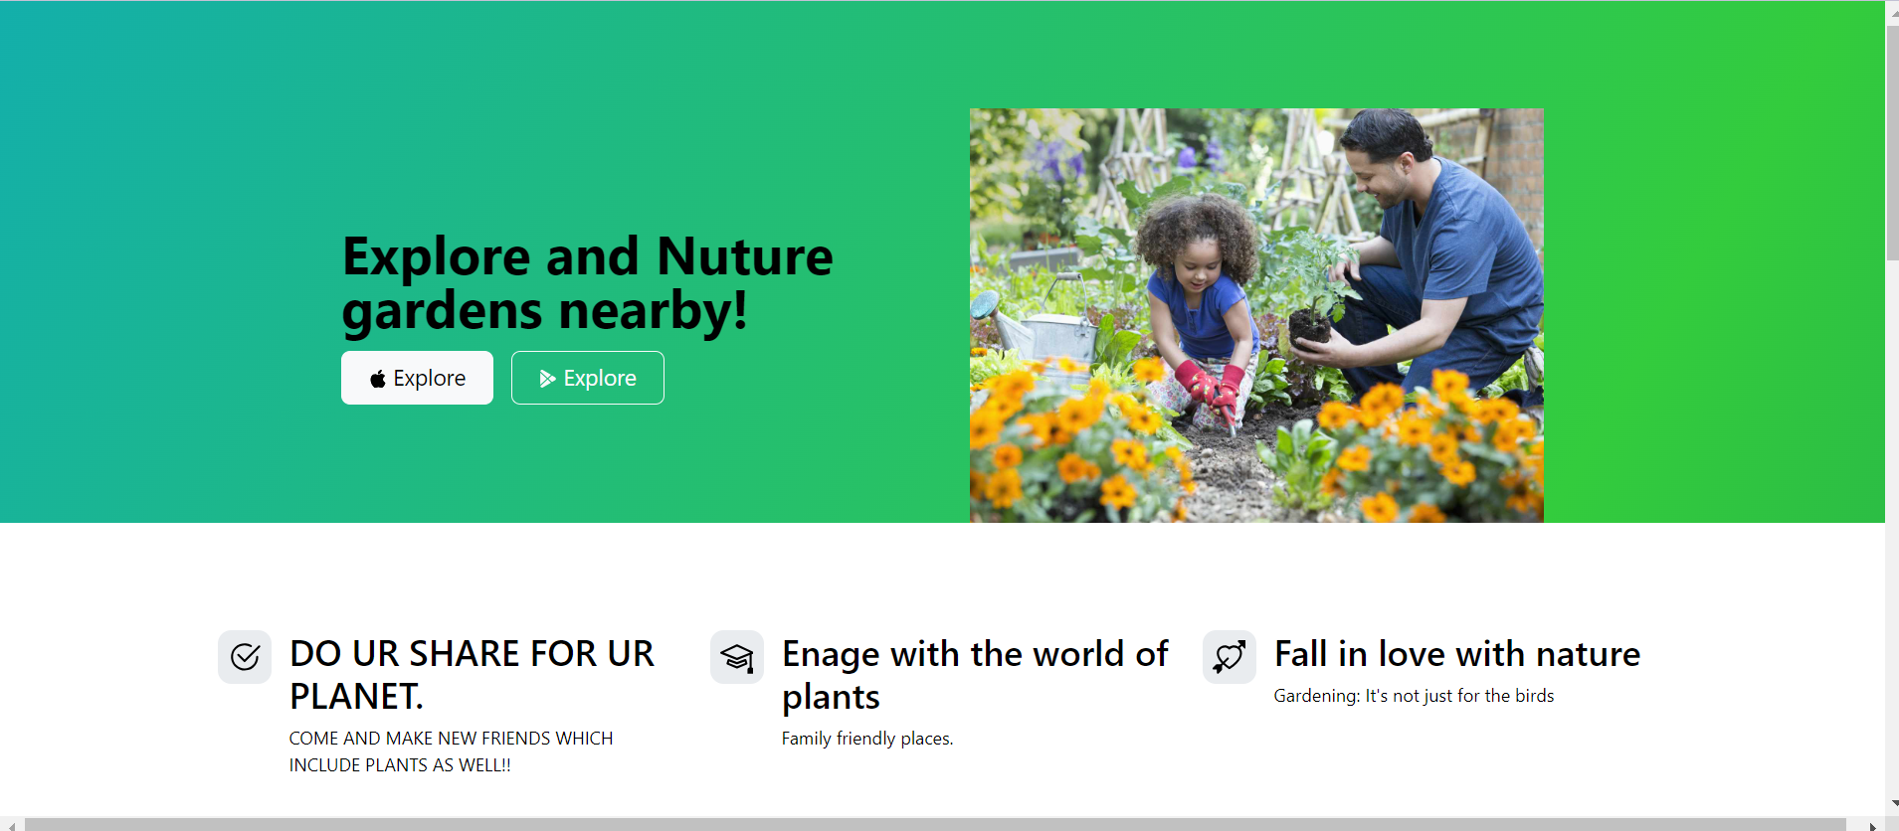

Slide 7
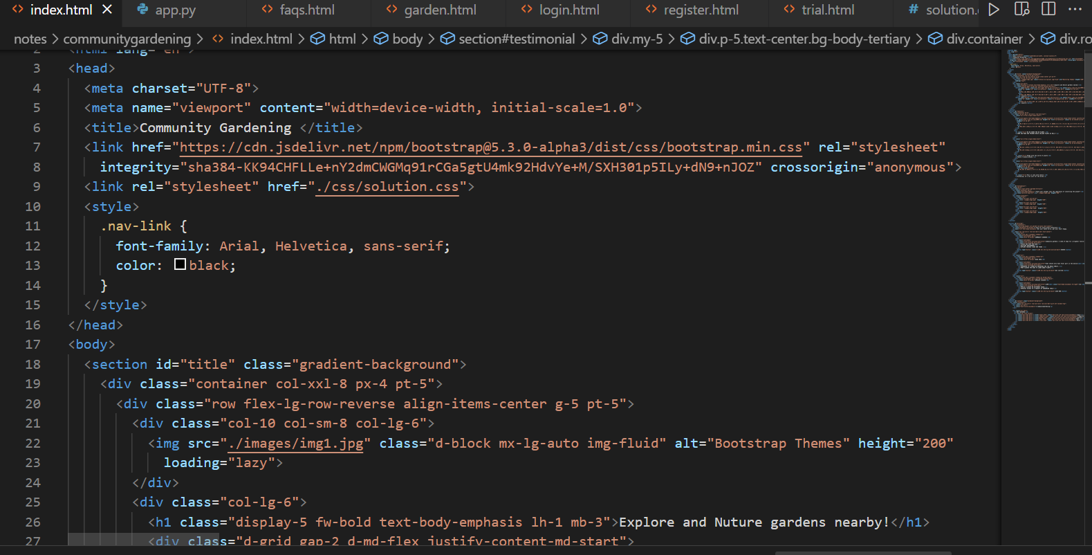

Slide 8
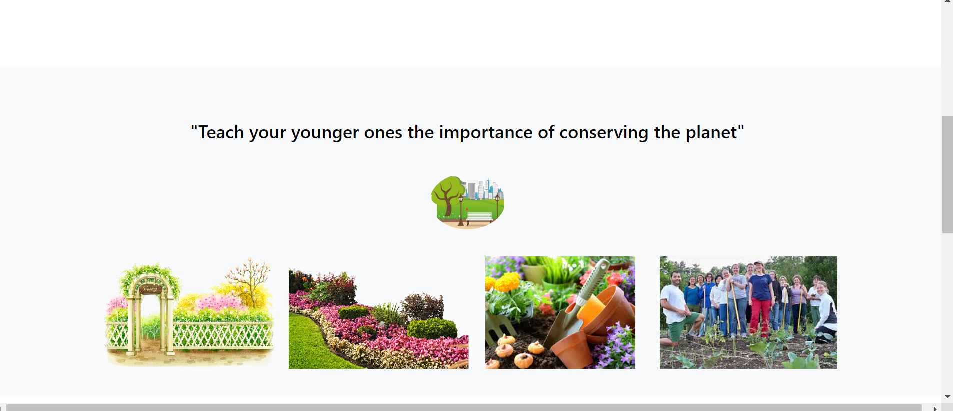

Slide 9
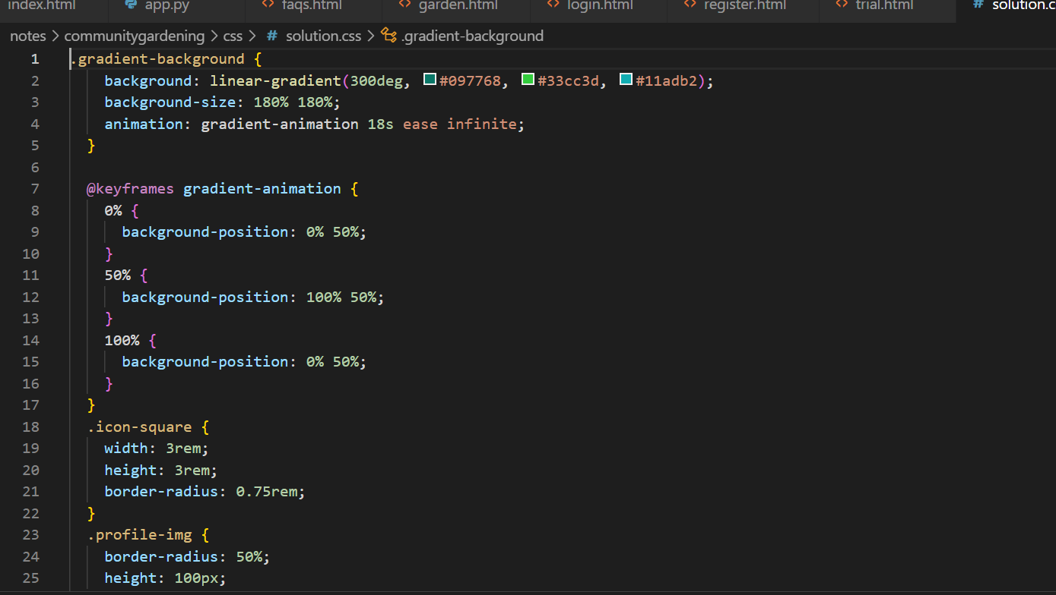
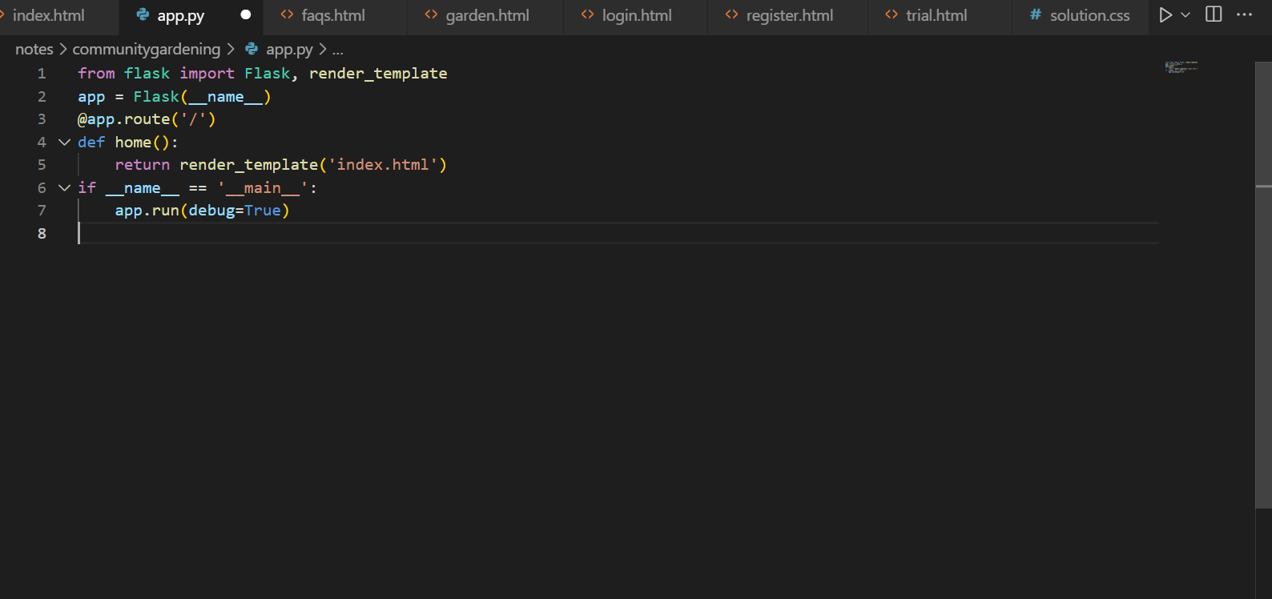

Slide 10
THANK YOU
!

